Slide 1
Light Sensors and Braitenberg Behaviors
Team 6:
Neil Forrester
Daniel Gonzalez
Raghavendra Srinivasan
James Wiken

Slide 2
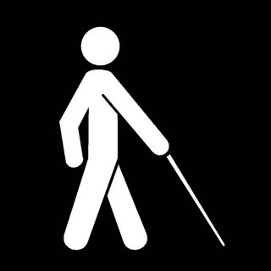
Simple reactive behaviors
Robots aren't useful if they can't adapt to what's happening in the real world.
There are ways around blindness, but there are limits to what's possible.

Slide 3
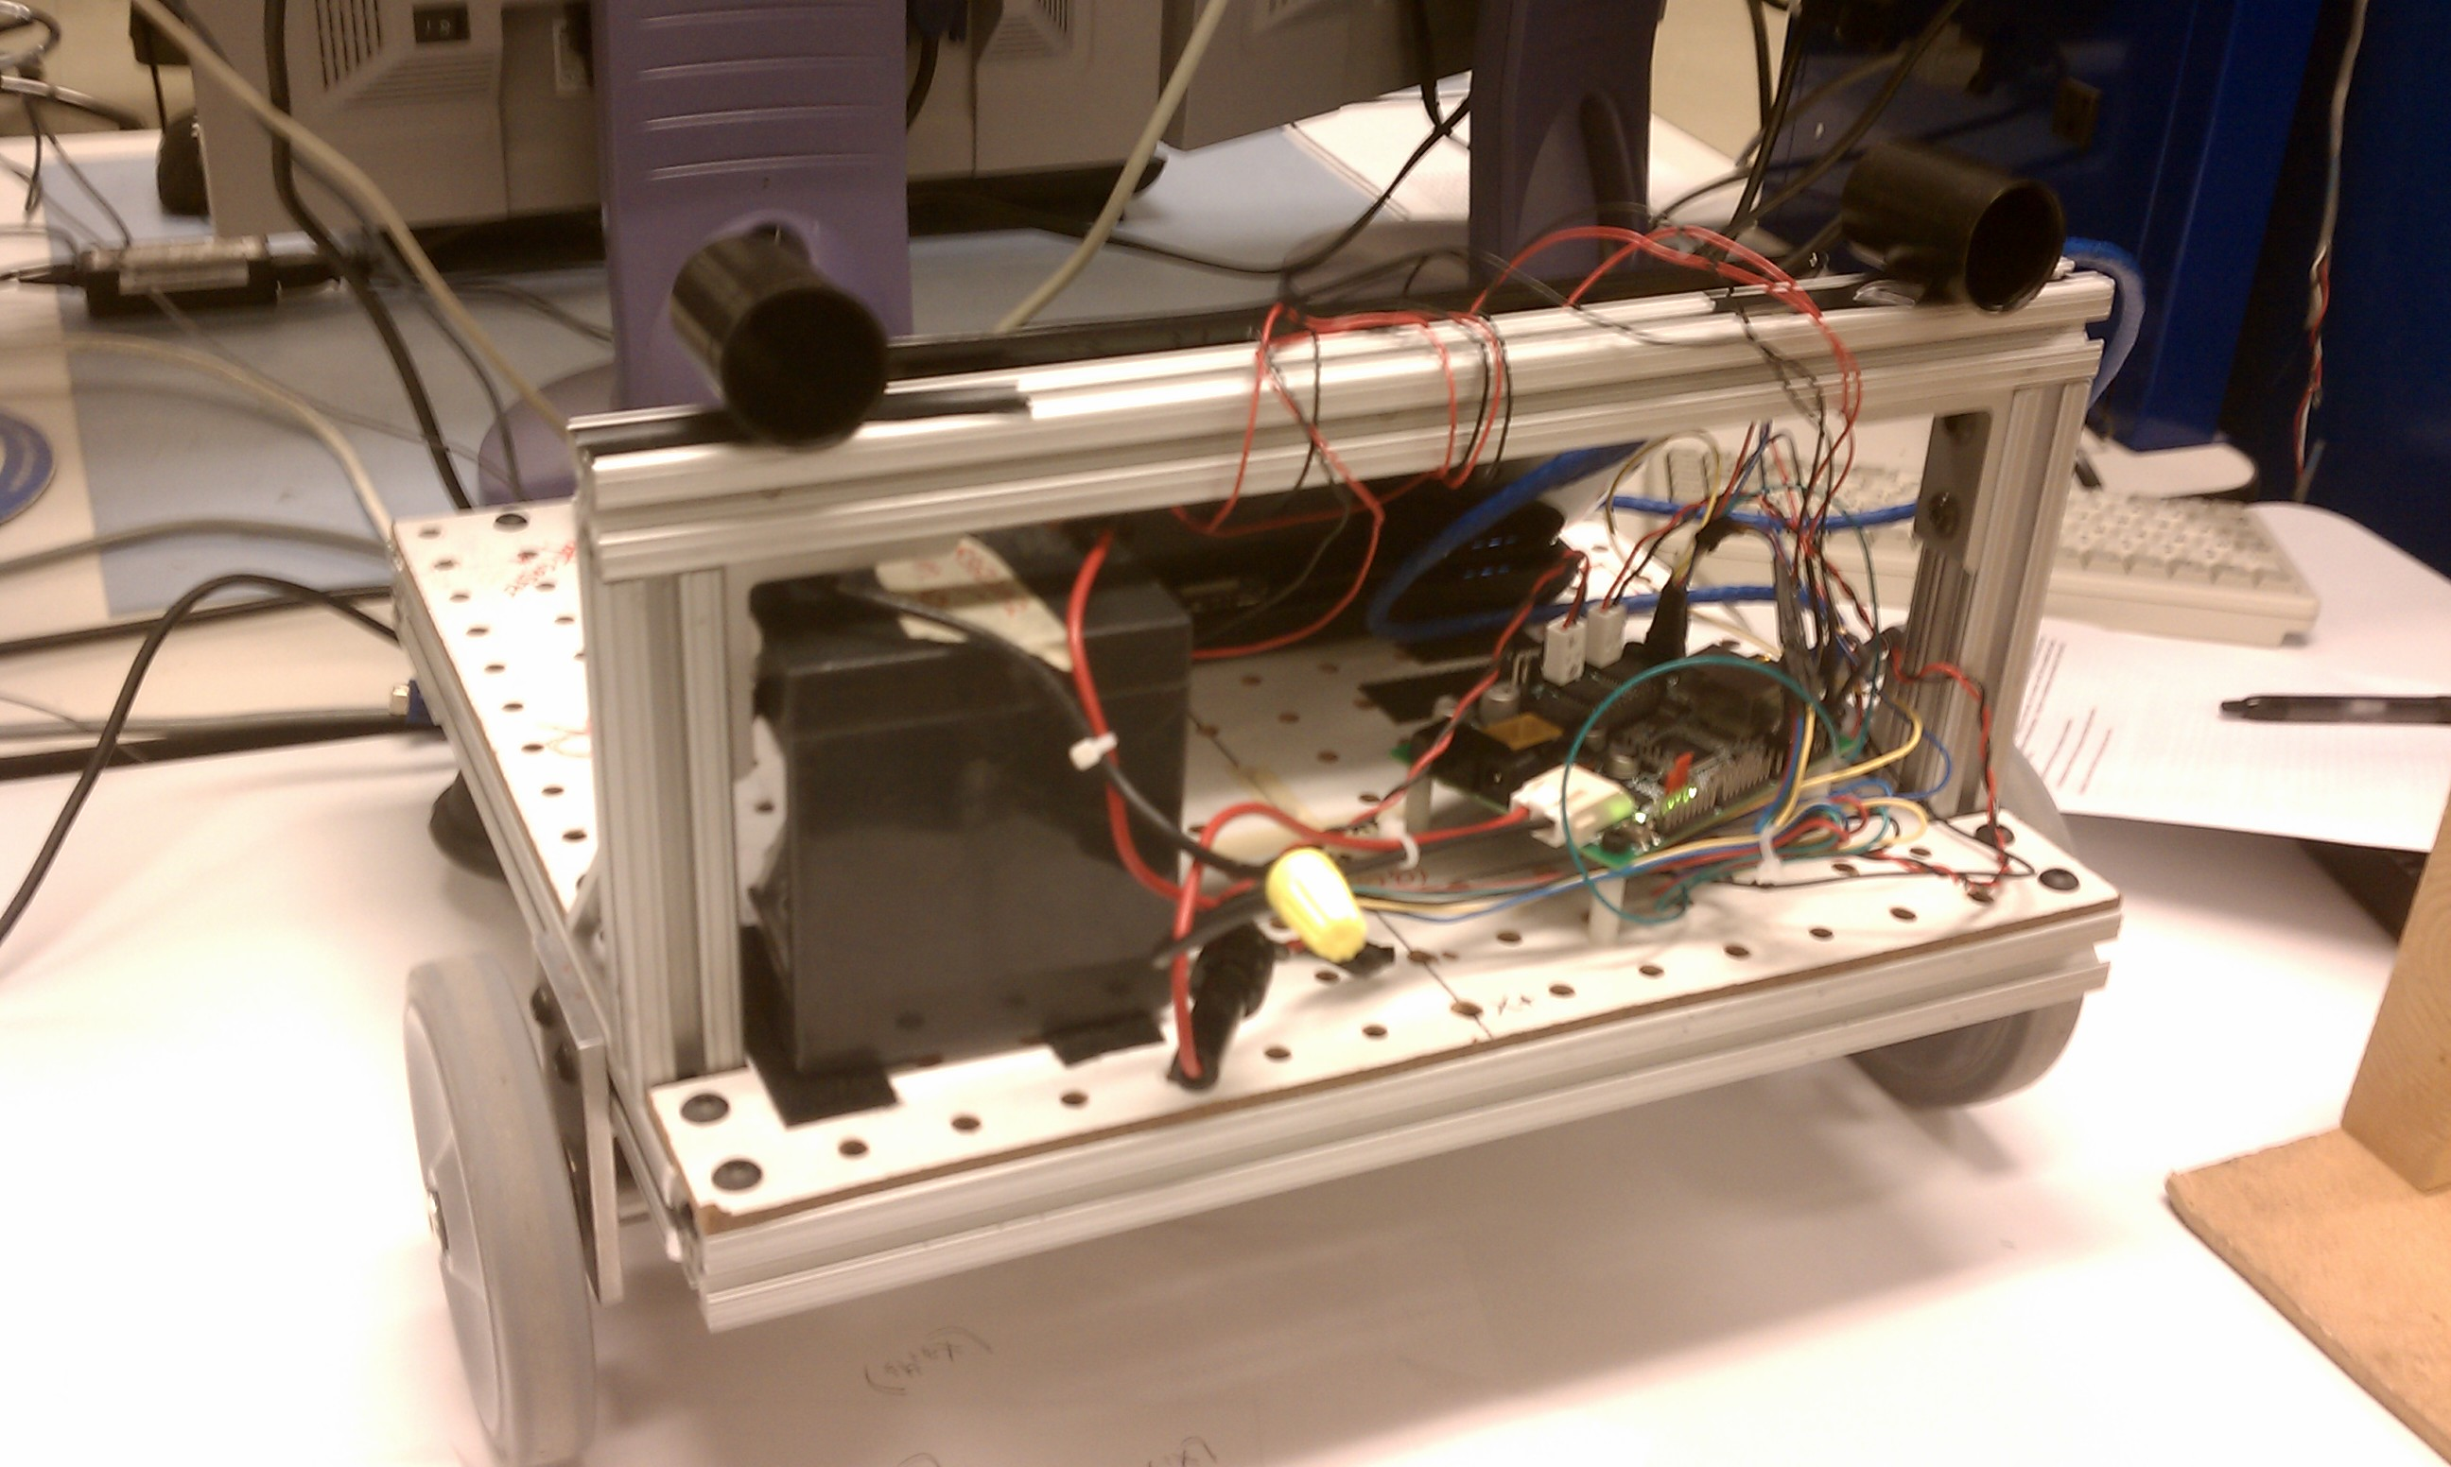
Light Sensors

Slide 4
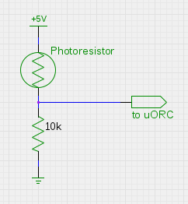
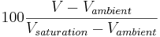
Photoresistor
Resistance:
Dark -
Ambient -
Saturation -
Calibration:

Slide 5
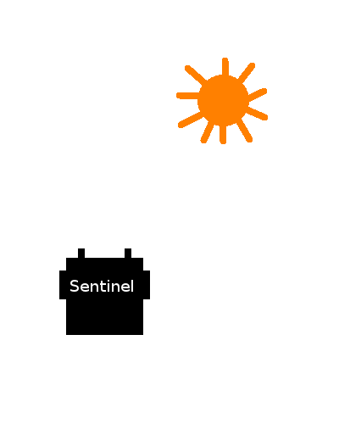
Searching for a light source
Low value
High value

Slide 6
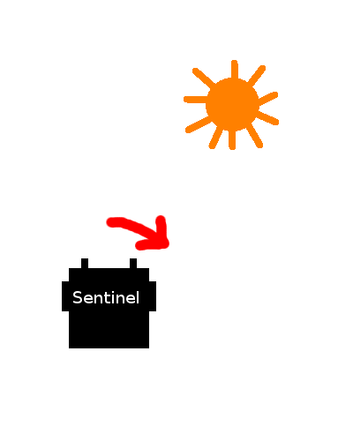
Searching for a light source
Low value
High value

Slide 7
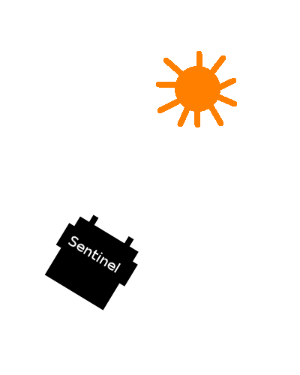
Searching for a light source
Roughly equal values

Slide 8
Moving to a light source
Values below threshold

Slide 9
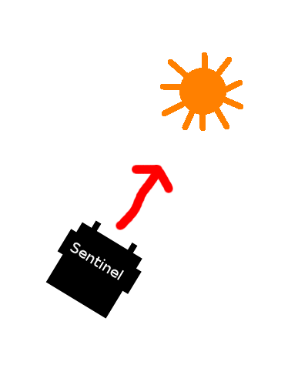
Moving to a light source
Values below threshold

Slide 10
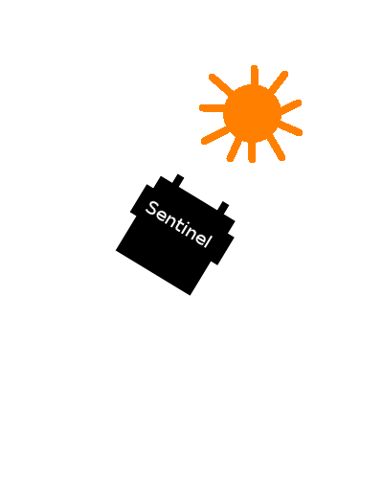
Moving to a light source
At least one value
above threshold

Slide 11
Braitenberg Behaviors
Wheel velocities are simple functions of light sensor values
With very little work the robot can follow or avoid lights, or seem to have a variety of emotions
Puppy!
Shy...
Aggressive!
Excited, but afraid.

Slide 12


Slide 13
What we learned
A wide range of emotions can be simulated with simple robot behavior in response to basic sensor input
Dan learned about photoresistors
Raga is good at video editing

